Slide 1
Implier – Arbitrage Examples
Ben Lackey

Slide 2
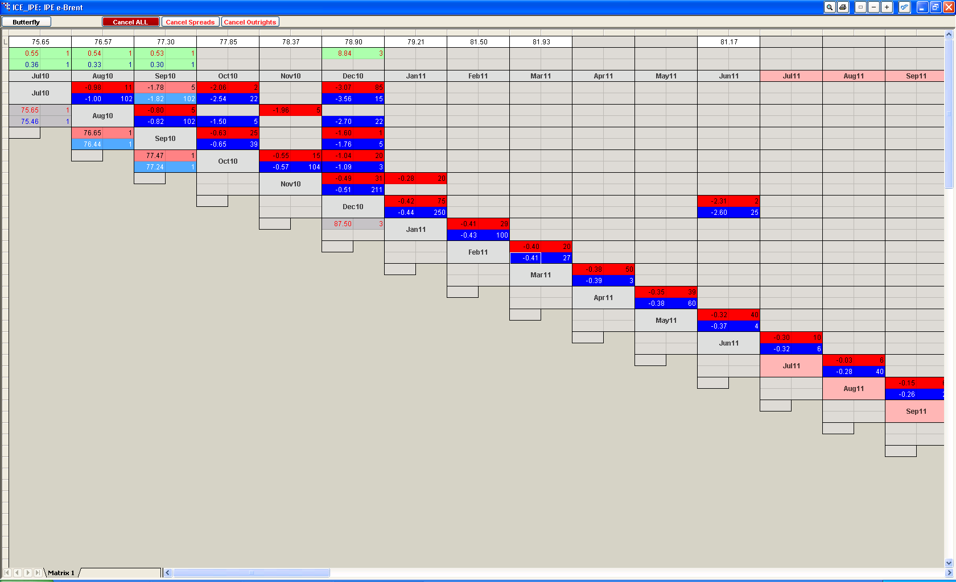
Spread Matrix in TT XTrader

Slide 3
Spread Matrix in TT XTrader
Red – Bid
Blue – Ask
Light Red – Combination of Implied Bid and Bid
Light Blue – Combination of Implied Ask and Ask
Gray – Outright Bid or Ask

Slide 4
Goal
Initially we want to create fully neutral positions eg +Jan, -Jan/+Feb, -Feb
Later we may want to create partially hedged positions eg butterflies, etc. eg –Jan, +Feb, -Mar, +Apr

Slide 5
Neutral Positions with Both the Underlying and Spread
-Jan
+Jan/-Feb
+Feb
-Jan
+Jan/-Feb
+Feb/-Mar
+Mar
+Apr
-Jan
+Feb/-Mar
+Mar/-Apr
+Jan/-Feb

Slide 6
Some Properties of Neutral Positions with Both the Underlying and Spread
If a contract is traded for n months, then there can be no more than n+1 legs in the longest trade.

Slide 7
Neutral Positions with Spread Only
+Jan/-Feb
+Feb/-Mar
+Jan/-Feb
+Feb/-Mar
-Jan/+Mar
-Jan/+Apr
+Mar/-Apr
+Jan/-Feb
+Feb/-Mar
+Mar/-Jun
-Jan/+Apr
-Apr/+Jun

Slide 8
Some Properties of Neutral Positions with Spread Only
If a contract is traded for n months, then there can be no more than n legs in the longest trade.

Slide 9
Questions – Butterflies, etc.
Do we want to trade butterflies, condors, etc. now?
Does the exchange imply with these instruments as well as the spreads?

Slide 10
Neutral Positions with Other MLEGs
+Jan/-Feb/+Mar
-Mar
+Jan/-Feb/+Mar/-Apr
-Jan
+Feb
-Jan/+Feb
-Mar/+Apr
+Jan/-Feb/+Mar/-Apr
-Mar/+Dec
-Jan/+May
+Feb/-Jun
+Apr/-Dec
-May/+Jun

Slide 11
Examples of Pure Arbitrage
Need to find a scenario where either
The ask add up to less than a bid
Buy the ask on Jan/Feb, Feb/Mar, Mar/Apr
Sell the bid on Jan/Apr
The bid add up to more than an ask
Sell the bid on Jan/Feb, Feb/Mar, Mar/Apr
Buy the ask on Jan/Apr

Slide 12
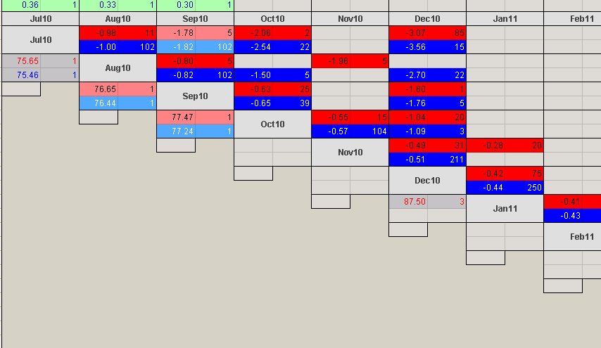
Zooming in for a Specific Example

Slide 13
Specific Example Continued
Sell the bid for -1.00 +Jul/-Aug
Sell the bid for -0.82 +Aug/-Sep
Sell the bid for -0.65 +Sep/-Oct
= Sell a synthetic +Jul/-Oct for -2.47
The actual Jul/Oct spread is offered at -2.06
However, let’s pretend the offer was -2.50 instead
Then we could sell the bid for -2.50
So, this gives 2.50-2.47=$0.03/barrel
This is a profit of 1000 barrels*$0.03=$30 per trade
The transaction cost is 12*$1.16 = $13.92
So, the arbitrage gives $15.08 profit/trade
We can do this trade max(contracts involved) = 2 times to give us $30.16

Slide 14
Exchanges/Symbols
Initially we’ll look at the following exchanges
CME
ICE
The first symbol we’ll concentrate on is ICE, B
After that, we’ll roll it out to
CME, CL, http://www.cmegroup.com/trading/energy/crude-oil/light-sweet-crude.html
ICE, B, https://www.theice.com/productguide/ProductDetails.shtml?specId=219
ICE, T, https://www.theice.com/productguide/ProductDetails.shtml?specId=213
CME, Brent
Later on interest rates, EURIBOR, Euro Dollars, Short Sterling

Slide 15
Terminology
The opposite of an implied is paper or direct.
A part of a spread, for example Jan in a Jan/Feb is called a side.

